Slide 1
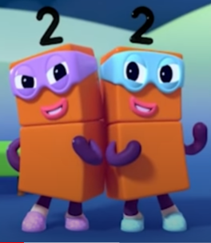
Maths
Double Trouble

Slide 2
https://www.youtube.com/watch?v=6ZnNfVZda6Y
Ctlr and click to watch Number blocks Double Trouble
In this episode the children will learn about doubling by observing how numberblocks 1, 2 and 4 double up to make numberblocks 2, 4 and 8.
In this episode children will also see the halving of 8, 4, and 2 to make 4, 2 and 1

Slide 3
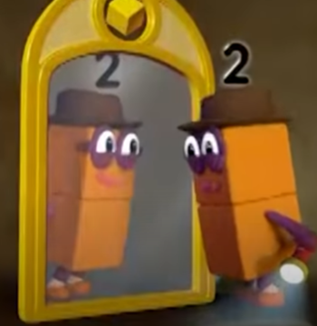
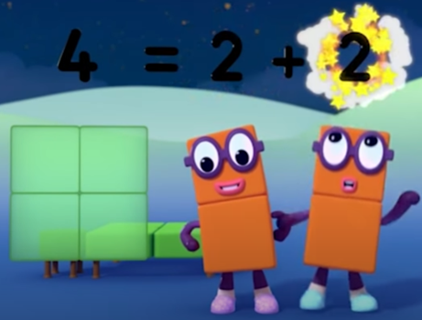
Talk about what you saw.

Slide 4
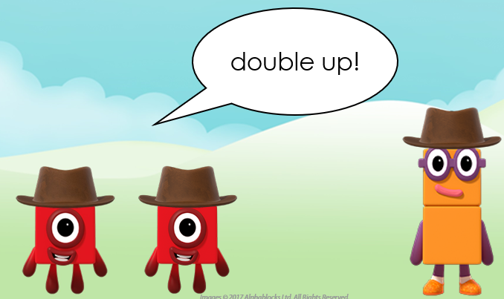
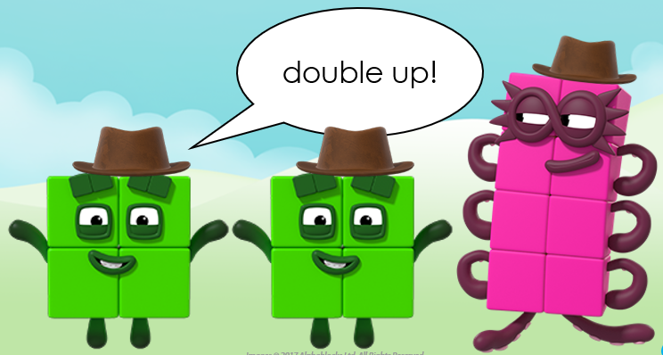
Using mathematical language. The children will learn the use of the word double which can be used in the following phrases.
One doubled is two
Double four is eight

Slide 5
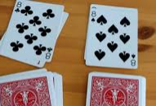
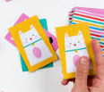
Activities to try at home.
Play a game of matching pairs or snap.
The player with the most ‘doubles’ is the winner.
Hide a set of single number cards around the garden. Give your child a number card and ask them to hunt around the garden to find the matching card. When they bring back the matching card, encourage them to say the double they have found e.g Double 2 is 4.
Draw the outline of a ladybird or butterfly. Use buttons, sequins, pom poms or pennies to add dots to each side. How many doubles can you make? Can you make one that is not a double? Tell your grown up why it is not a double.

