Slide 1
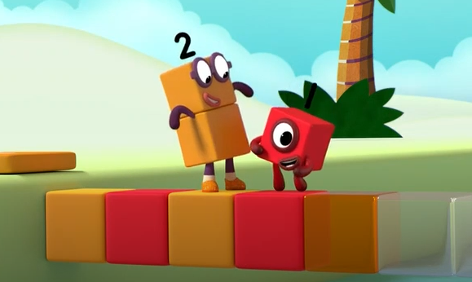
Patterns

Slide 2
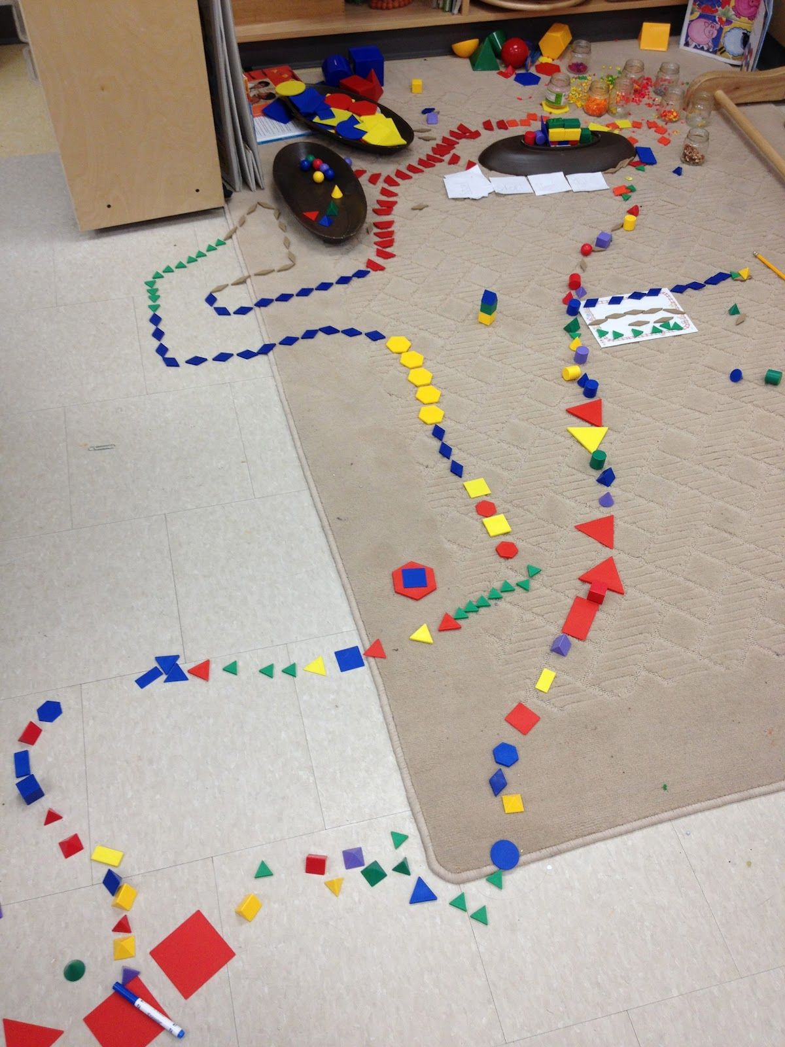
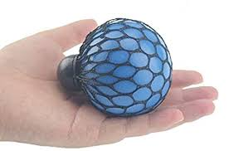
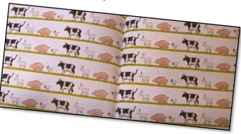
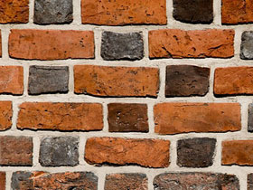
Patterns are everywhere!
Have a look around and see what patterns you can find.
Talk to your grown up about the patterns that you see.
You can also make and hear patterns such as in the alphabet or days of the week songs and when playing musical instruments or clap pat copy cat games.

Slide 3
Watch this episode of Numberblocks https://www.youtube.com/watch?v=U__EFzinbA8

Slide 4
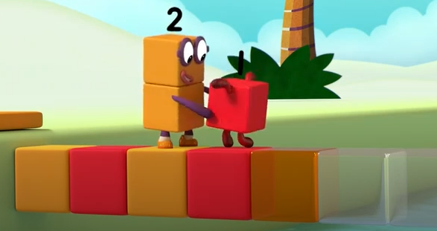
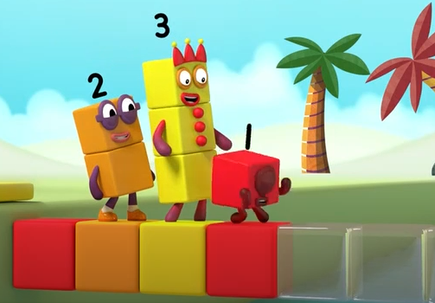
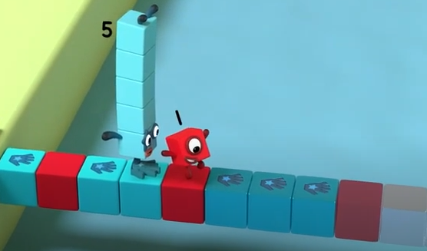
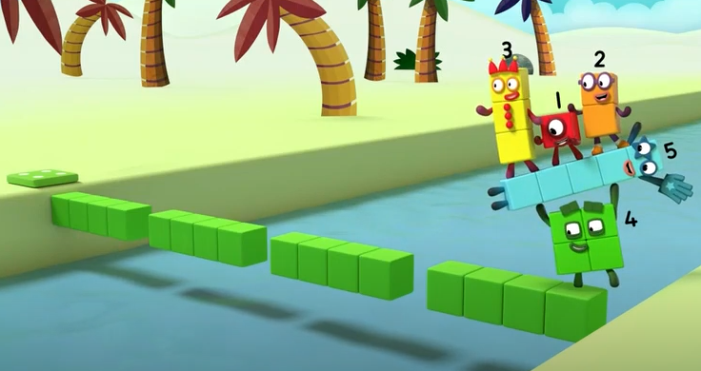
Talk together about what you saw.
Where you able to say what came next and why?

Slide 5
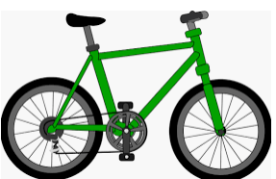
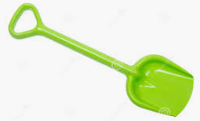
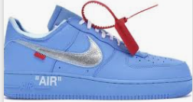
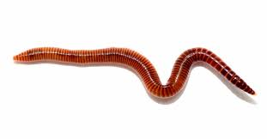
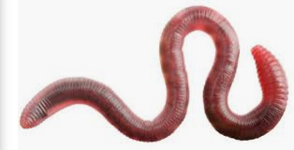
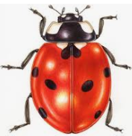
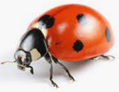
AB pattern example -red, blue, red, blue.
ABC pattern eg red, green, blue, red, green, blue
ABB pattern eg red, blue, blue, red, blue, blue
or

Slide 6
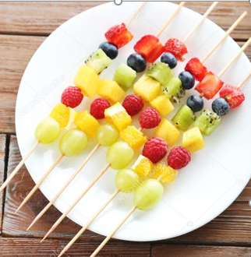
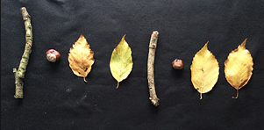
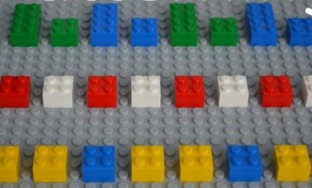
Maybe you could make your own repeating patterns at home.

Slide 7
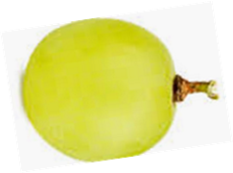
More fun with patterns.
https://www.youtube.com/watch?v=Waoa3iG3bZ4
Read or listen to the story of Going on a Bear Hunt and listen out for the patterns in the story.
Swishy, swashy, swishy swashy. Squelch, squerch, squelch, squerch.
Arrange snacks into patterns and talk about the pattern; for example raisin raisin grape, raisin raisin grape.
Make a mistake in the pattern and talk about what has happened; can your child fix it?
Use real or home made musical instruments (pots and pans) and use them to make sound patterns. Turn away whilst your child makes a pattern and then try to guess which instruments they used to make the pattern.

Slide 8
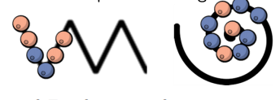
Copy cat pattern game.
Start with a simple ab pattern such as pat knees, clap hands, pat knees, clap hands and ask your child to copy.
Say the pattern out loud and encourage your child to copy. Repeat with more AB patterns such stand, sit, stand, sit,
hands up, hands down. Let your child choose and you copy.
Once your child is confident with an AB pattern, you can extend to an ABC pattern for example tap knees, tap shoulders,
tap head or hop, jump, kick, hop, jump, kick.
Bits and pieces patterns
Find small objects such as stones, small sticks, buttons, bottle tops, small shapes etc. Draw shapes or lines on paper or in chalks outside and encourage your child to follow the lines with a pattern of objects.

Slide 9
Extra Challenge

