Slide 1
Year 4 Maths
Division
Play the PowerPoint in slide show mode (bottom right)

Slide 2
Patterns and Connections
4 x 100 =
3 x 100 =
100 x 2 =
6 x 100 =
100 x 5 =
8 x 100 =
100 x 1 =
100 x 7 =

Slide 3
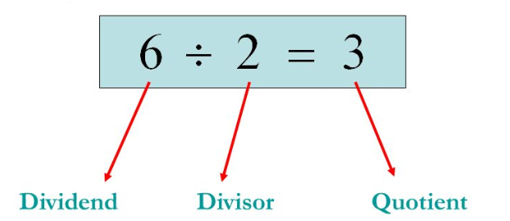
Dividing two and three-digit numbers by a single digit (no exchanging or remainders)
We are going to be dividing through grouping.
This time we will be using the bus stop method.
48 ÷ 2 =
I have modelled each step for you.
Reminder:

Slide 4
24
48 ÷ 2 =
2
4
2
4
8
How many 2s are there in 4? Remember, it is not really a 4 but a 40!
How many are left over?
How many 2s are there in 8?
Great!

Slide 5
23
69 ÷ 3 =
2
3
3
6
9
How many 3s are there in 6? Remember, it is not really a 6 but a 60!
How many are left over?
How many 3s are there in 9?
Great!

Slide 6
88 ÷ 4 =
22
2
2
4
8
8
How many 4s are there in 8? Remember, it is not really a 8 but a 80!
How many are left over?
How many 4s are there in 8?
Great!

Slide 7
You have a go! Remember, when using the bus stop method we need to start with the largest value first.
28 ÷ 2 =
39 ÷ 3 =
68 ÷ 2 =
84 ÷ 4 =

Slide 8
Let’s have a go with 3-digits.
211
633 ÷ 3 =
2
1
1
3
6
3
3
How many 3s are there in 6? Remember, it is not really a 6 but a 600!
How many 3s are there in 3? Remember, it is not really a 3 but a 30!
How many 3s are there in 3?
Great!

Slide 9
Let’s have a go with 3-digits.
134
268 ÷ 2 =
1
3
4
2
2
6
8
How many 2s are there in 2? Remember, it is not really a 2 but a 200!
How many 2s are there in 6? Remember, it is not really a 6 but a 60!
How many 2s are there in 8?
Great!

Slide 10
You have a go! Remember, when using the bus stop method we need to start with the largest value first.
286 ÷ 2 =
396 ÷ 3 =
628 ÷ 2 =
484 ÷ 4 =

Slide 11
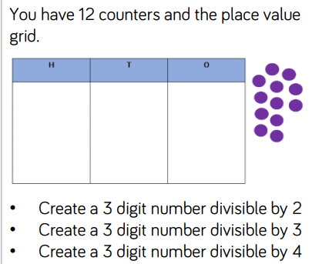
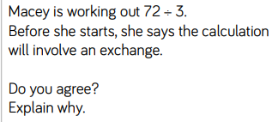
If you would like to do extra, try these:
Mrs Claydon-Bell sharpens 448 coloured pencils. She shares them between 4 tables. How many pencils does each table get?
Draw out a place value grid and either draw the counters on or use household items (Lego, dried pasta, etc) as the counters.

Slide 12
Great work everyone!

