Slide 1
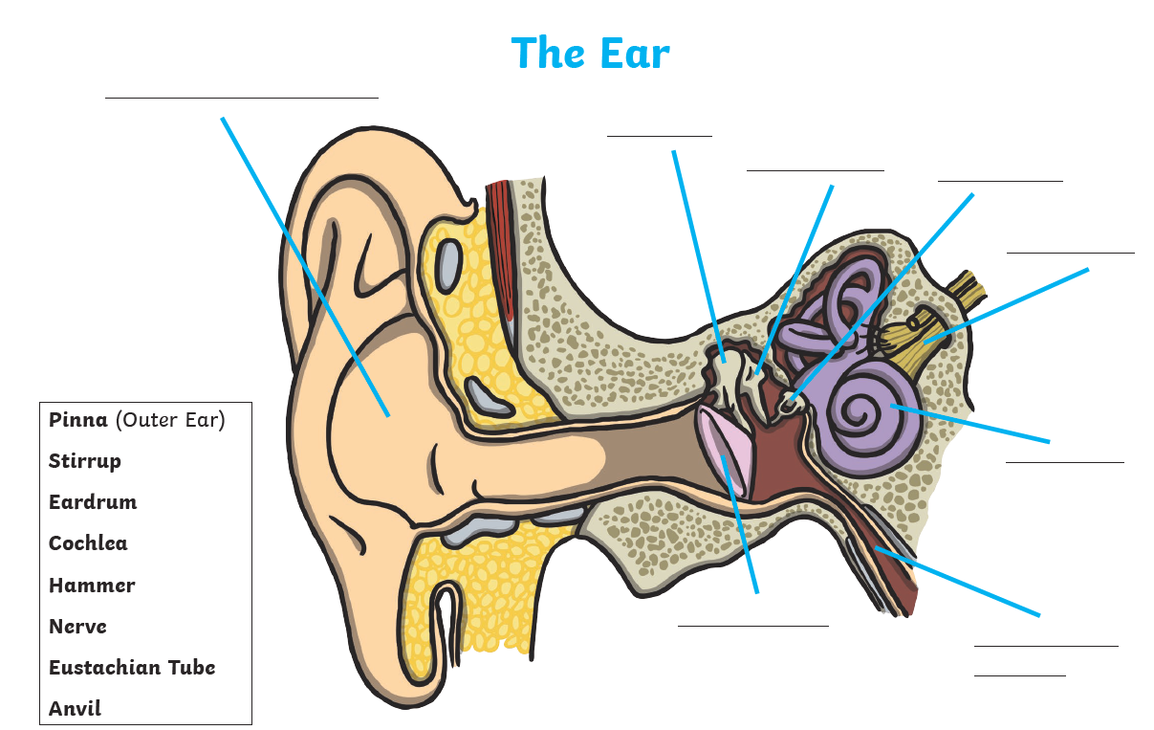
Auditory canal

Slide 2
1. The vibrations pass along the auditory nerve to your brain.
2. The ear-drum vibrates when a sound hits it.
3. Your brain sorts the message and you hear the sound.
4. Your outer ear channels the sound waves into your ear.
5. The vibrating ear-drum makes the little bones in your ear vibrate.
6. The sound waves travel along the auditory canal.
© SaveTeachersSundays.com 2013

