Slide 1
Class 4 Literacy
The Impossibly Possible Bookshop
Session 1

Slide 2
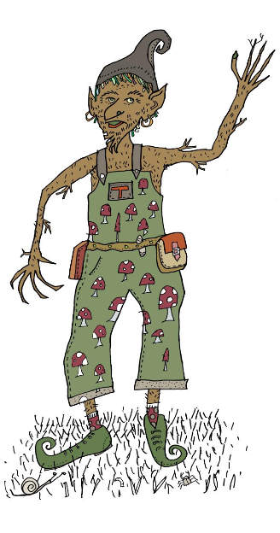
The Impossibly Possible Bookshop by Kat Pennington
Hello,
My name is Treerumple. This story is all about when a boy called Sammy came to visit me in my special TreeGoblin world. I am going to guide you through the work and, at the end, I would love to read your magical stories.

Slide 3
You need to read the story of The Impossibly Possible Bookshop – I have put it on the website as a separate PDF.
You can also listen to it here:
https://soundcloud.com/talkforwriting/bookshop/s-WQRn0LBZ1ho

Slide 4
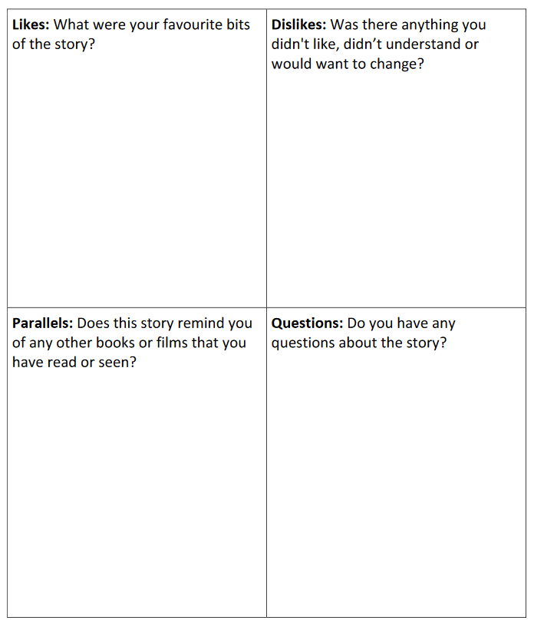
Let’s chat about the story…
What did you think of the story?
You can write down your answers or discuss them with an adult or older sibling at home.
Think about any vocabulary or phrasing you are unsure about – write them down and we will come back to them in another session.

Slide 5
End of session 1
I hope you enjoyed the story – you will need to reread it several times over the next few weeks in order to complete the activities.

