Slide 1
Class 4 Literacy
The Impossibly Possible Bookshop
Week 11
Session 1

Slide 2
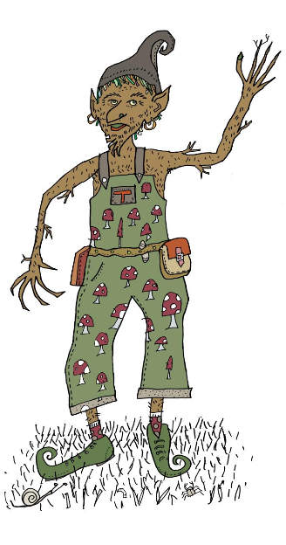
The Impossibly Possible Bookshop by Kat Pennington
Hello!
Remember me? Treerumple here again. Remind yourself of the story by rereading or listening to it again.
We’re going to do some work around vocabulary – there are quite a few tricky words in the text!

Slide 3
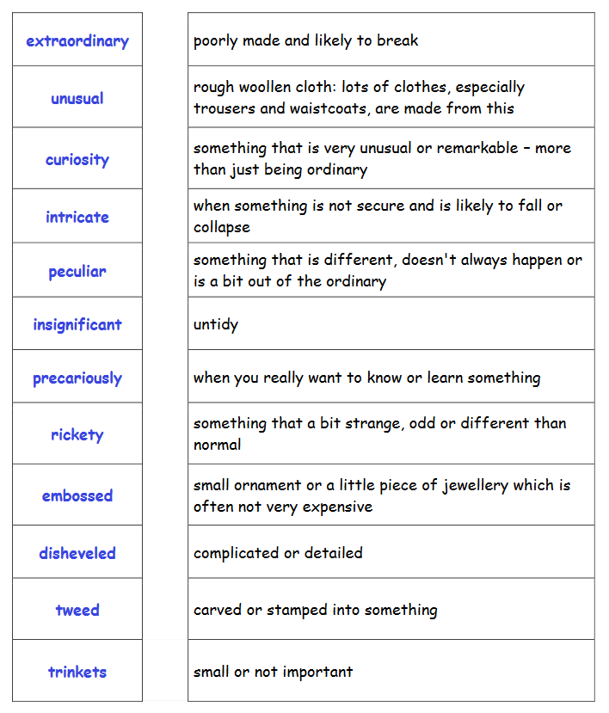
Vocabulary
These words appear in the story at some point and are quite tricky – did you highlight any of these words?
Can you match the words to their correct definitions? I have attached the words as a separate PDF for those of you who would like to cut them up and match together.
The correct answers are at the end of the PPT.

Slide 4
Are there any other words you are not sure of? Write them down and ask an adult if you can or use the internet or look in a dictionary if you have one.
Now, choose 5 words from the previous slide and write them in your own sentence. I have done two examples for you:
Insignificant
The little mouse seemed insignificant to the other animals.
Intricate
An old lady, with an intricate necklace, walked into the shop.

Slide 5
Characters – let’s get creative!
Did you know there are lots of different types of goblins in the world?
Here are just some examples that I know of: Cloud Goblin, Mountain Goblin, Fridge Goblin, Storm Goblin, Bog Goblin…There are many more!
Goblins are usually linked to weather, nature or places – can you think of any more?

Slide 6
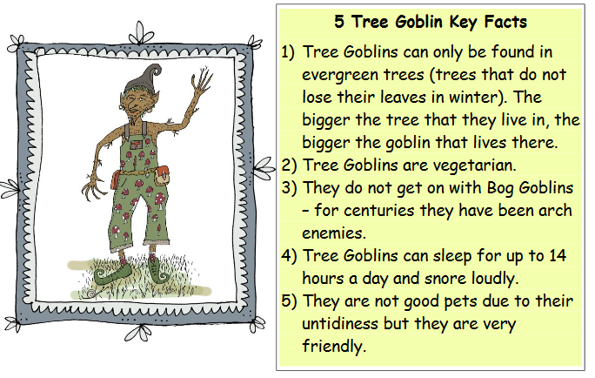
Now, choose three of your favourite ideas and draw the goblins in a picture frame. Can you write 5 facts that everybody should know about them? I have done an example of the Tree Goblins for you.

Slide 7
End of session 1
Well done everyone. Feel free to send your work to year4@ashgrove.cheshire.sch.uk
I look forward to seeing what Goblins you have created ☺.

Slide 8
