Slide 1
Class 4 Literacy
The Impossibly Possible Bookshop
Week 12
Session 2

Slide 2
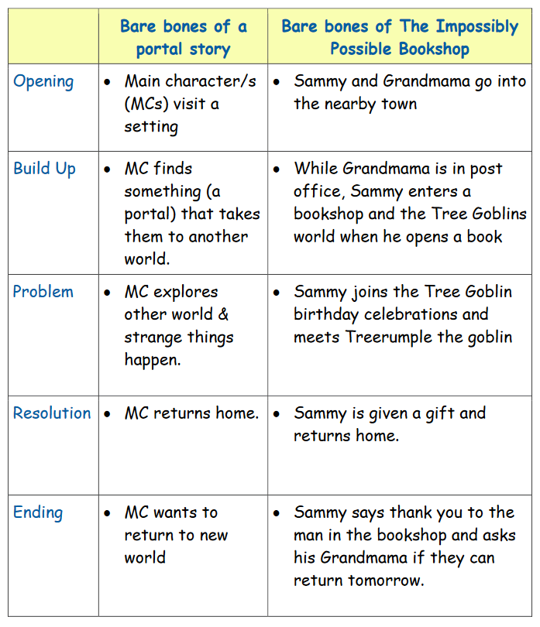
Writing your own story
Let’s look at the structure for The Impossibly Possible Bookshop.

Slide 3
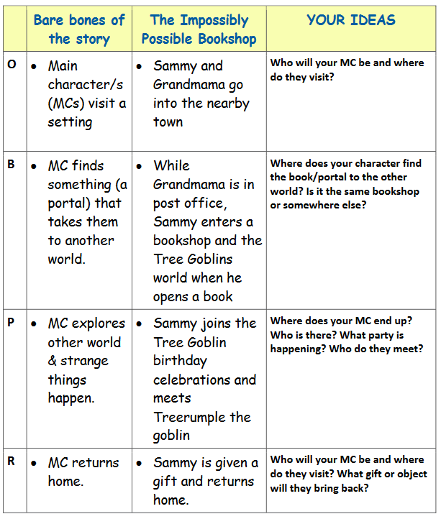
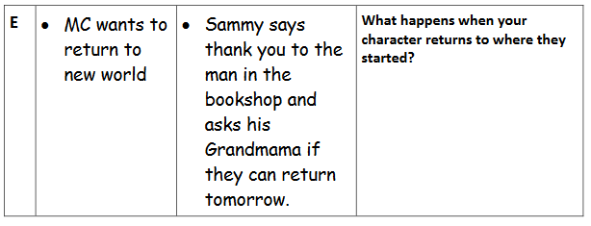
Use the grid to help you plan your own ideas for the story.

Slide 4
Writing your story
Remember to write it in parts and to reread each section to check for cohesion.
If you like, you could illustrate each section of your story or even write it as a graphic novel!
Don’t forget your basic skills!!

Slide 5
This was your final piece of literacy work for Year 4! Well done on completing your literacy home learning activities. I hope you have enjoyed them!
You have been amazing and should be very proud of your resilience and hard work. I am very much looking forward to teaching you in Year 5 ☺.

