Slide 1
Class 4 Literacy
Week 3
Session 1
In this session, we are going to be writing our story. You might want to do this in chunks and take a break between each section or write the whole story in one go – it is entirely up to you. Try your best and have fun!
You need to look through this as a slide show as there are animations

Slide 2
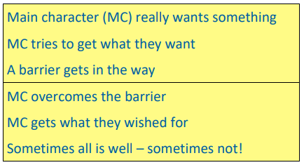
Skills
Fronted adverbials – use your examples from last week.
Expanded noun phrases – 1 or more adjectives + noun.
Commas after fronted adverbials
Don’t forget the basics:
Capital letters and basic punctuation used correctly
Neat handwriting
I have written it in chunks and then text marked it to demonstrate where I have included the skills.
Click through the whole of the next slide before you start writing yours. You can always go back to check skills, etc.

Slide 3
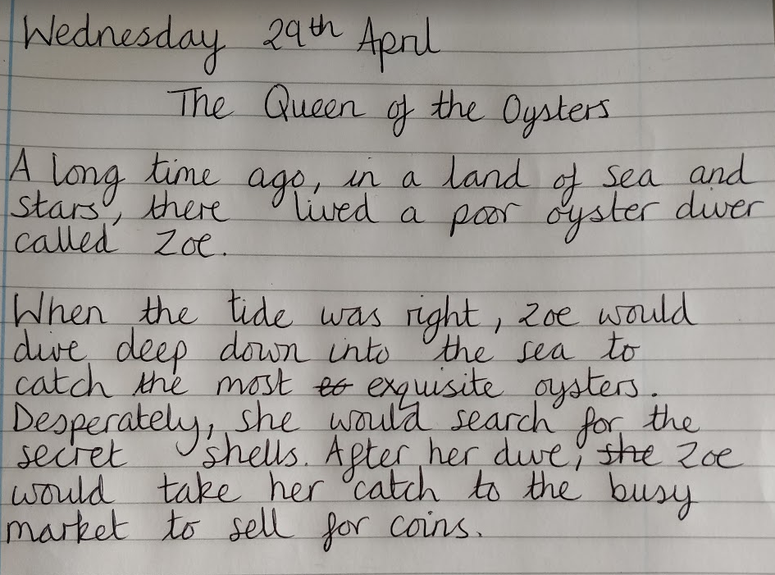
Let’s start writing the first section…
Fronted adverbials – use your examples from last week.
Expanded noun phrases – 1 or more adjectives + noun.
Commas after fronted adverbials
Don’t forget the basics:
Capital letters and basic punctuation used correctly
Neat handwriting
Bank of phrases you might like to use:
A long time ago,
Once upon a time,
Long, long ago
In a land of sea and stars,
In a land of sun and sand,
In a land beyond the mountains,
In a land where palm trees grow,
Far out into space, where the stars shine bright…
Deep in the jungle,
At the top of the tallest mountain,
These are just some examples, you do not have to use any of them if you do not wish to.
Fronted adverbials to tell the reader when, where or how something is happening.
Expanded noun phrases for description.
Commas after fronted adverbials.

Slide 4
Now you have a go at writing the first section of your story.
Reread what you have written – does it make sense?
Check your punctuation and spelling:
Have you remembered full stops? Are there capital letters after the full stops? Have you remembered the comma after your fronted adverbials?
Don’t forget, you can always go back to the previous slide to check.

Slide 5
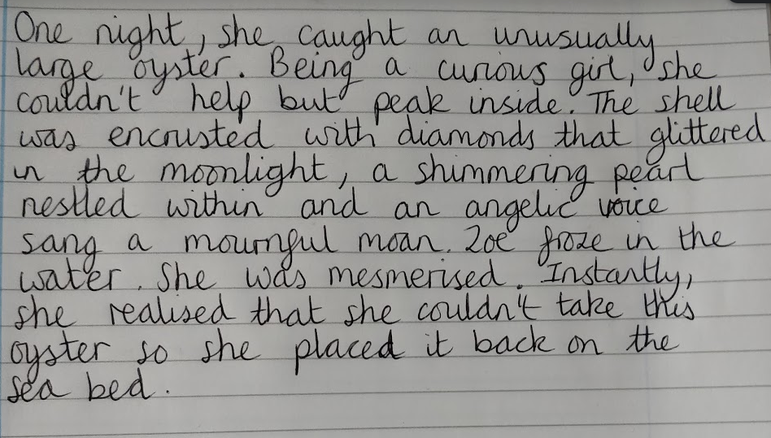
Let’s start writing the second section…
Fronted adverbials – use your examples from last week.
Expanded noun phrases – 1 or more adjectives + noun.
Commas after fronted adverbials
Don’t forget the basics:
Capital letters and basic punctuation used correctly
Neat handwriting
I have introduced the new character that is going to be helped in some way by Zoe.
I have described the new character in detail.
Fronted adverbials to tell the reader when, where or how something is happening.
Expanded noun phrases for description.
Commas after fronted adverbials.
A relative clause – these start with who, which, whose, that, where, when.

Slide 6
Now you have a go at writing the second section of your story.
Reread what you have written – does it make sense?
Check your punctuation and spelling:
Have you remembered full stops? Are there capital letters after the full stops? Have you remembered the comma after your fronted adverbials?
Reread what you have written – does it make sense?
Check your punctuation and spelling:
Have you remembered full stops? Are there capital letters after the full stops? Have you remembered the comma after your fronted adverbials?
Don’t forget, you can always go back to the previous slide to check.

Slide 7
Let’s start writing the third section…
Fronted adverbials – use your examples from last week.
Expanded noun phrases – 1 or more adjectives + noun.
Commas after fronted adverbials
Don’t forget the basics:
Capital letters and basic punctuation used correctly
Neat handwriting
Fronted adverbials to tell the reader when, where or how something is happening.
Commas after fronted adverbials.
Inverted commas for speech.
Remember to include a capital letter at the start of speech and punctuation at the end, before you close speech with an inverted comma.

Slide 8
Now you have a go at writing the third section of your story.
Reread what you have written – does it make sense?
Check your punctuation and spelling:
Have you remembered full stops? Are there capital letters after the full stops? Have you remembered the comma after your fronted adverbials?
Reread what you have written – does it make sense?
Check your punctuation and spelling:
Have you remembered full stops? Are there capital letters after the full stops? Have you remembered the comma after your fronted adverbials?
Don’t forget, you can always go back to the previous slide to check.

Slide 9
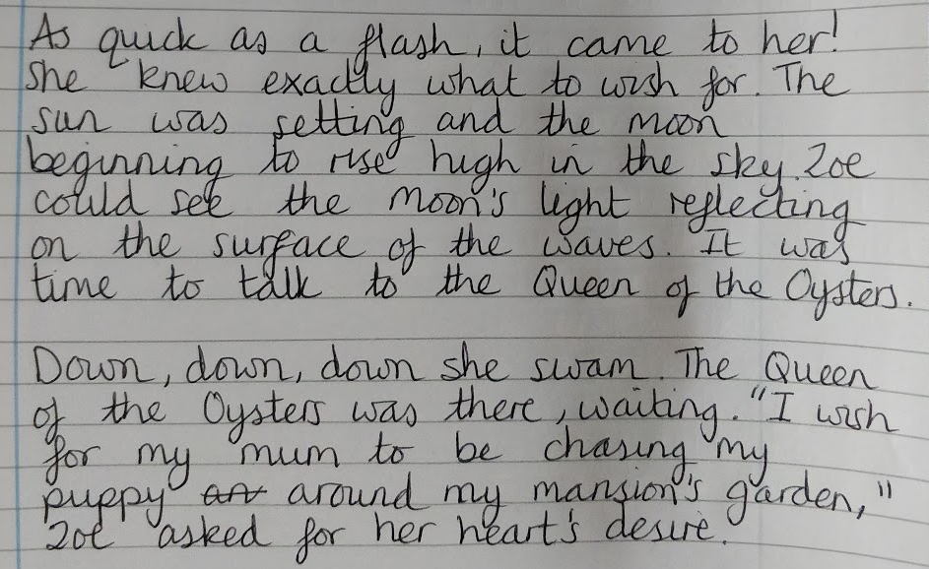
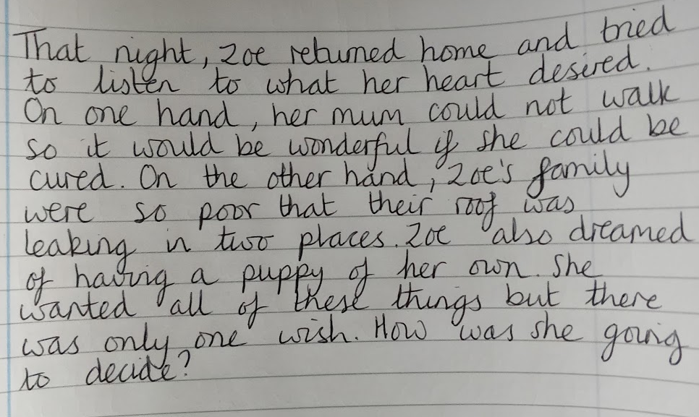
Let’s start writing the fourth and fifth section…
Fronted adverbials – use your examples from last week.
Expanded noun phrases – 1 or more adjectives + noun.
Commas after fronted adverbials
Don’t forget the basics:
Capital letters and basic punctuation used correctly
Neat handwriting

Slide 10
Now you have a go at writing the fourth and fifth sections of your story.
Reread what you have written – does it make sense?
Check your punctuation and spelling:
Have you remembered full stops? Are there capital letters after the full stops? Have you remembered the comma after your fronted adverbials?
Reread what you have written – does it make sense?
Check your punctuation and spelling:
Have you remembered full stops? Are there capital letters after the full stops? Have you remembered the comma after your fronted adverbials?
Don’t forget, you can always go back to the previous slide to check.

Slide 11
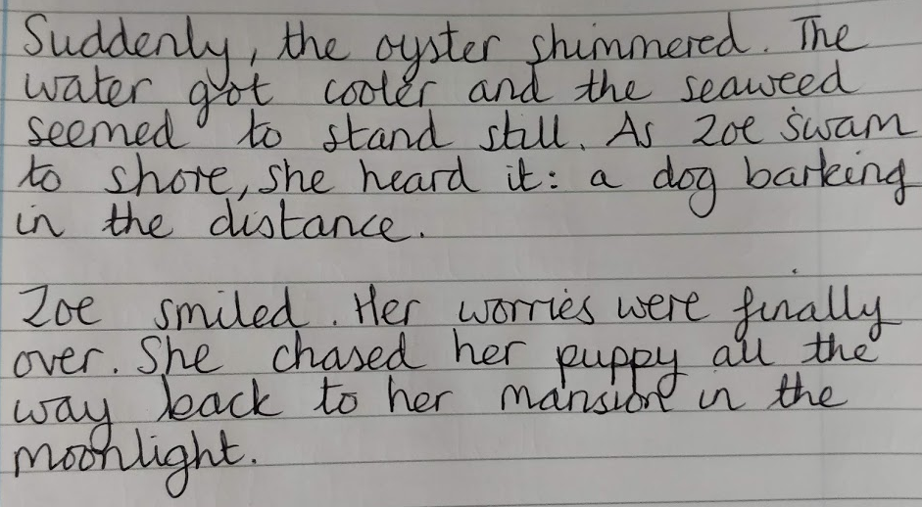
The ending…
Fronted adverbials – use your examples from last week.
Expanded noun phrases – 1 or more adjectives + noun.
Commas after fronted adverbials
Don’t forget the basics:
Capital letters and basic punctuation used correctly
Neat handwriting

Slide 12
Now you have a go at writing the ending of your story.
Reread what you have written – does it make sense?
Check your punctuation and spelling:
Have you remembered full stops? Are there capital letters after the full stops? Have you remembered the comma after your fronted adverbials?
Reread what you have written – does it make sense?
Check your punctuation and spelling:
Have you remembered full stops? Are there capital letters after the full stops? Have you remembered the comma after your fronted adverbials?
Don’t forget, you can always go back to the previous slide to check.

Slide 13
Publishing
If you wish to, you could publish your story by writing it up in neat and illustrating. This is an optional extra – you do not have to do it.

Slide 14
You have finished! Amazing work – well done for being so resilient! I look forward to reading your stories ☺.
You can tweet work to @ashgroveyear4 or email it to year4@ashgrove.cheshire.sch.uk

