Slide 1
Inference Class 4 Week 4

Slide 2
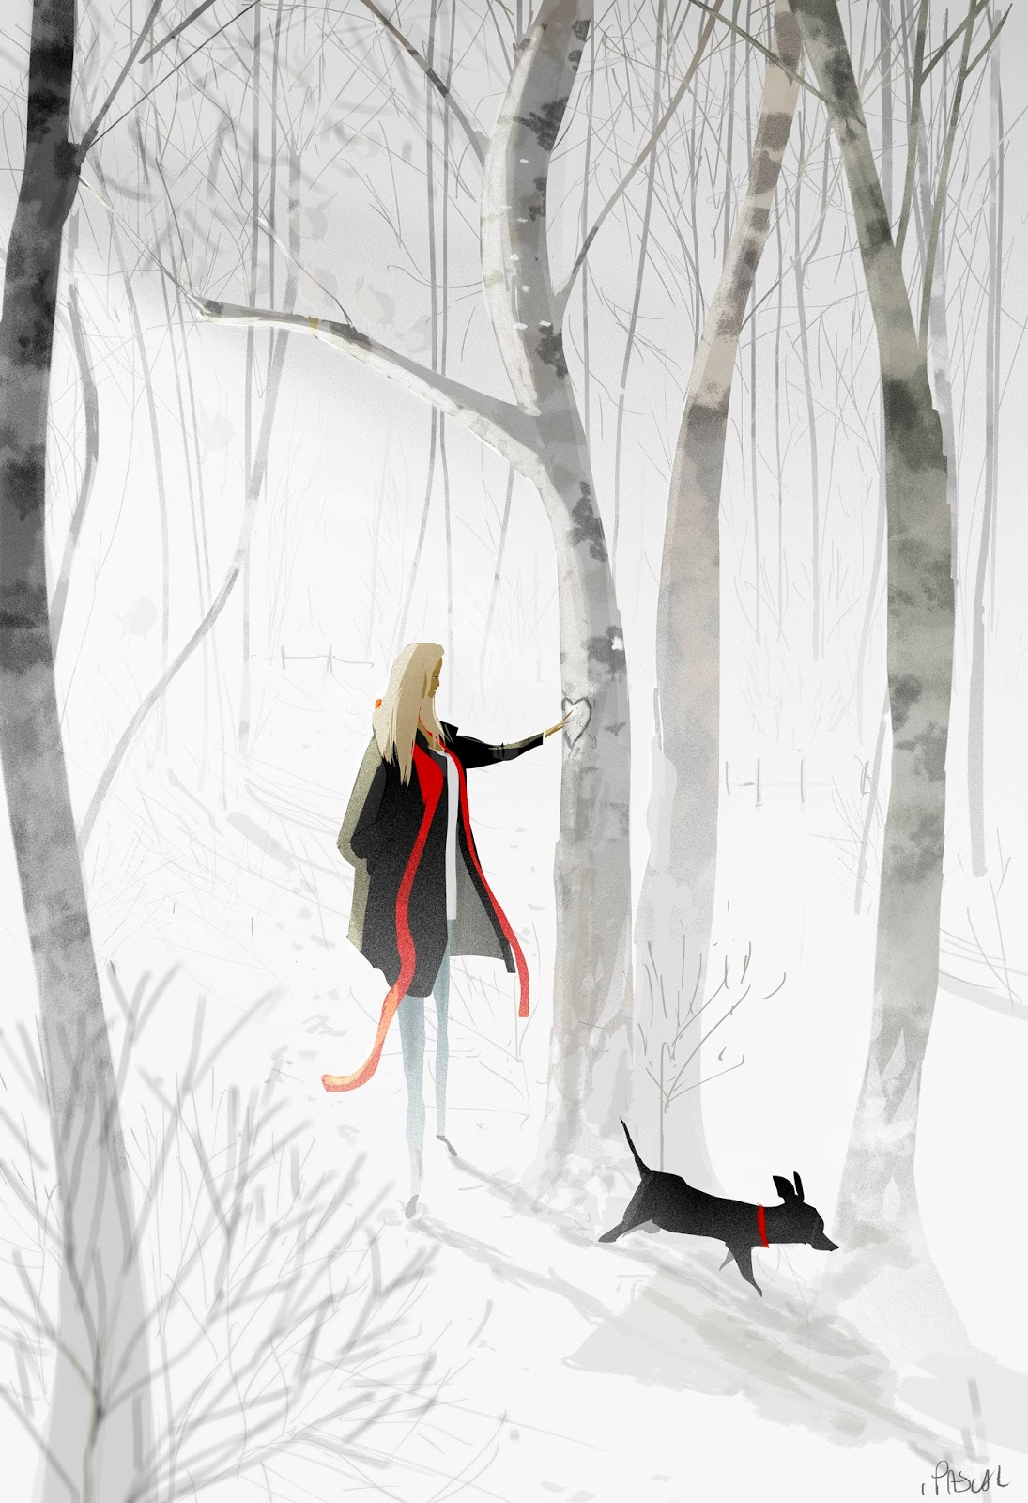
Memories
Where do you think this is?
When is this? (What time of year/day?)
What is the woman doing?
Who do you think carved the heart into the tree? Why do you think they did it?
Why do you think is she touching it?
Why do you think this picture called ‘Memories’?
What is she remembering?

