Slide 1
Literacy Class 4 Week 4

Slide 2
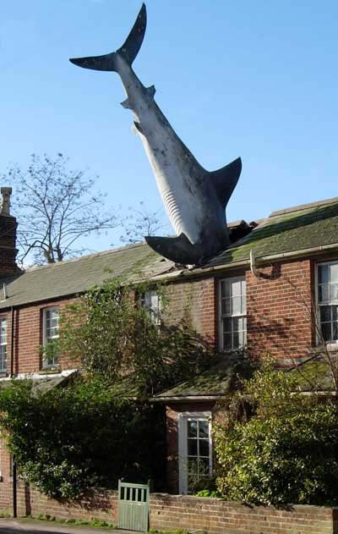
What questions does this image make you think of?

Slide 3
Did you ask the same as me?
How did the shark get there?
Where did it come from?
Was anyone in the house at the time?
Were there any eyewitnesses?
How did the residents of the street react?
What happened to the shark in the end?
Use your imagination to write some answers to these questions, and the questions you thought of!

Slide 4
Activity: Create a short piece of writing based on this image. You can choose the genre: a poem, a short story, a newspaper report, or an eye-witness account, etc. You must remember basic skills: * Correct use of capital letters. * Basic punctuation used correctly. * Neat handwriting.

