Slide 1
Class 4 Maths
Week 5
Improper Fractions and mixed numbers

Slide 2
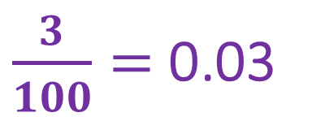
Patterns and Connections
$\frac{3}{100}=$ 0.03
Convert the hundredths into decimals
$\frac{4}{100}= \frac{6}{100}=$
$\frac{2}{100}= \frac{8}{100}=$
$\frac{5}{100}= \frac{9}{100}=$
$\frac{10}{100}=$

Slide 3
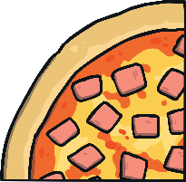
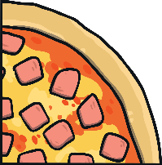
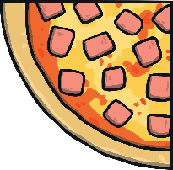
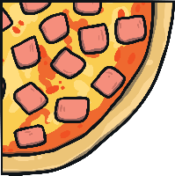
Improper fractions to mixed numbers
You can convert an improper fraction into a mixed number.
Divide the numerator (7) by the denominator (4). In other words - how many times does 4 ‘fit’ into 7 completely?
7 ÷ 4 = 1 r3
7
4
1 r3 written as a mixed number is v
1
3
4

Slide 4
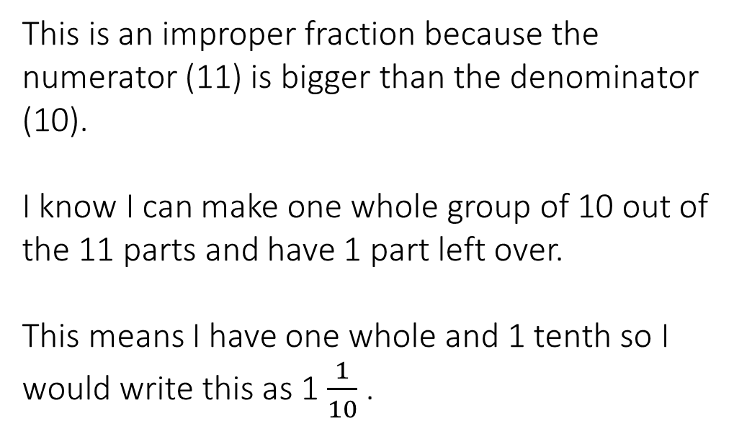
Writing improper fractions as mixed numbers:
This is an improper fraction because the numerator (11) is bigger than the denominator (10).
I know I can make one whole group of 10 out of the 11 parts and have 1 part left over.
This means I have one whole and 1 tenth so I would write this as 1 $\frac{1}{10}$ .
11
10

Slide 5
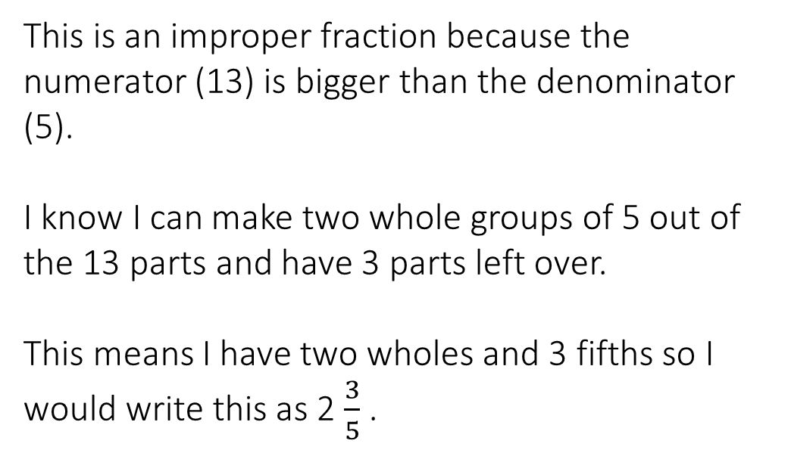
Writing improper fractions as mixed numbers:
This is an improper fraction because the numerator (13) is bigger than the denominator (5).
I know I can make two whole groups of 5 out of the 13 parts and have 3 parts left over.
This means I have two wholes and 3 fifths so I would write this as 2 $\frac{3}{5}$ .
13
5

Slide 6
Write these improper fractions as mixed numbers:
5
14
4
9

Slide 7
Did you get them correct?
14
1
5
5
1
=
1
9
9
=
4
4

Slide 8
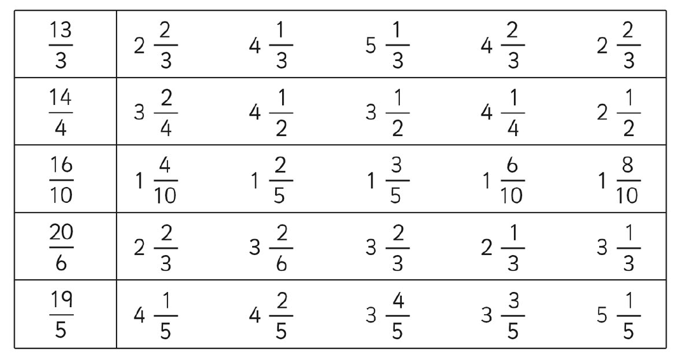
Circle or write down the mixed number that is the same as the improper fraction. The first one has been done for you.

Slide 9
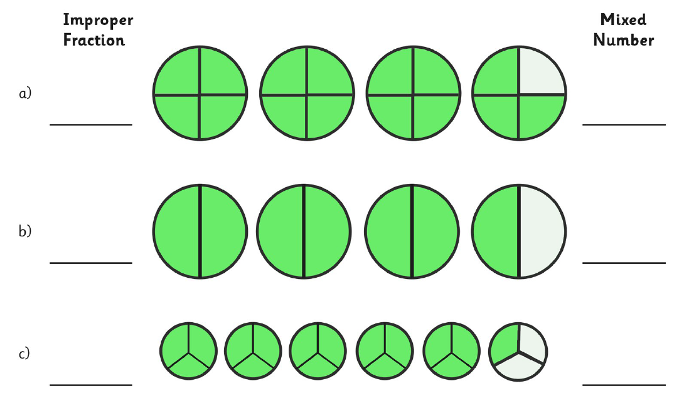
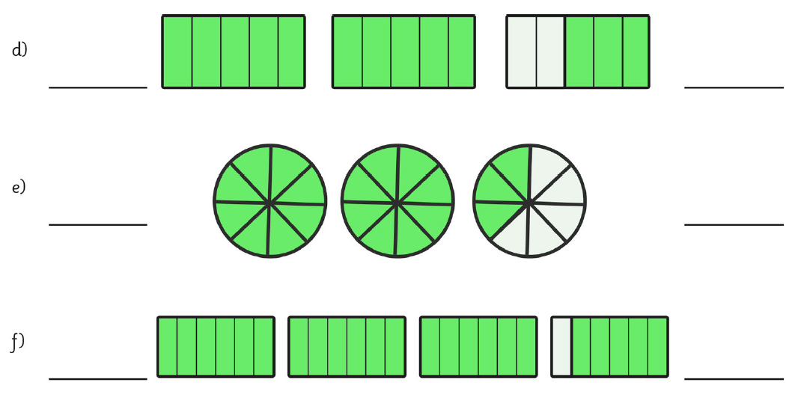
$$\frac{15}{4}$$
$$3\frac{3}{4}$$

