Slide 1
Class 4 Maths
Week 6
Converting mixed numbers to improper fractions

Slide 2
Patterns and Connections
Greater than, less than or equal to? Use >, < or = to complete the following:
$\frac{3}{5}$ $\frac{7}{5}$
$\frac{4}{5}$ $\frac{2}{5}$
$\frac{3}{5}$ $\frac{9}{5}$
$\frac{5}{5}$ $\frac{7}{5}$
$\frac{6}{5}$ $\frac{6}{5}$

Slide 3
Reminder Improper fractions to mixed numbers
Remember, to convert an improper fraction into a mixed number, you need to find out how many times the denominator ‘fits’ into the numerator.
Numerator
$\frac{19}{4}$
$4 \frac{3}{4}$
=
Denominator
How many times does 4 ‘fit’ completely into 19?
4
8
12
16

Slide 4
Now we will look at changing a mixed number into an improper fraction
Multiply the whole number by the denominator
Add your answer to the numerator
Put that number on top of the denominator
So, 2 (whole number) x 2 (denominator) = 4
Then, 4 + 1 (numerator) = 5.
The denominator stays the same and the bigger number goes on top so it is $\frac{5}{2}$ .
1
5
2
=
2
2
The denominator always stays the SAME!

Slide 5
Let’s try another one together. Convert the mixed number to an improper fraction:
Multiply 4 x 2 = 8
2) Add 8 + 1 = 9
3) On top $\frac{9}{2}$
1
9
4
2
2

Slide 6
You try now:
Convert the mixed number to an improper fraction:
1) Multiply 2) Add 3) On top!
2
11
3
3
3

Slide 7
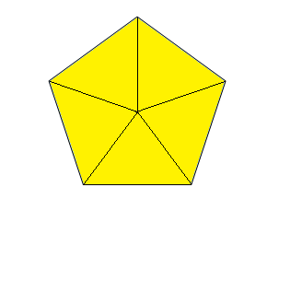
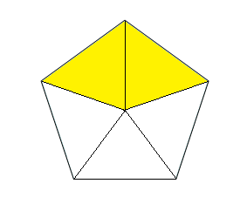
Convert the mixed number to an improper fraction:
2
12
2
5
5

Slide 8
Activity Have a go at changing these mixed numbers into improper fractions. Draw the models if you need to.

Slide 9
Use >, < or = to make these statements true
$1\frac{4}{6}$ $\frac{12}{6}$
2$\frac{3}{5}$ $\frac{10}{5}$
$2\frac{2}{5}$ $\frac{12}{5}$
3$\frac{4}{5}$ $\frac{16}{5}$

Slide 10
Miss Lucas has a party. She orders 5 pizzas. She eats $\frac{7}{4}$ of the pizza. Her friend eats $1\frac{1}{4}$. Who eats the most pizza?

Slide 11
End of sessions 1. Well done everyone! You have worked hard to convert between mixed numbers and improper fractions.

