Slide 1
Class 4 Maths
Week 6
We are now moving on to adding and subtracting fractions. We will spend a few sessions on this.

Slide 2
Patterns and Connections
Greater than, less than or equal to? Use >, < or = to complete the following:
1 $\frac{4}{5}$ $\frac{7}{5}$
$\frac{7}{5}$ 1 $\frac{2}{5}$
$\frac{13}{5}$ 2 $\frac{4}{5}$
$\frac{5}{5}$ 1
1$\frac{1}{5}$ $\frac{6}{5}$

Slide 3
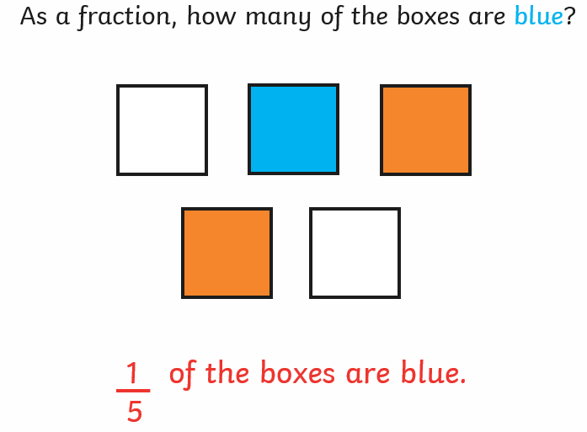
Adding and subtracting fractions with the same denominator
Fractions can be added and subtracted. It is much easier to do when the denominators are both the same number.

Slide 4
Adding with the same denominator
Jessie and James share a chocolate bar.
2
7
4
7
Jessie eats of it.
James eats of it.
As a fraction, how much of the chocolate bar did Jessie and James eat all together?
2
7
4
7
=
6
7
+

Slide 5
Adding with the same denominator
Adding Fractions
2
6
3
6
5
6
+
=
red
green

Slide 6
Adding with the same denominator
Adding Fractions
0
4
1
4
2
4
3
4
4
4
2
4
1
4
3
4
+
=

Slide 7
Adding with the same denominator
0
5
1
5
2
5
3
5
4
5
5
5
2
5
2
5
4
5
+
=

Slide 8
Adding with the same denominator
0
8
1
8
2
8
3
8
4
8
5
8
6
8
7
8
8
8
3
8
3
8
6
8
+
=

Slide 9
Your turn:
Remember, the denominator stays the same!
How many different additions can you find?

Slide 10
Subtracting Fractions
Subtracting fractions with the same denominator is just as simple!
Write down your calculation.
Your answer will have the same denominator.
Find the difference between the numerators – you have you answer!
5
3
2
Numerator:
=
6
6
6
Denominator:

Slide 11
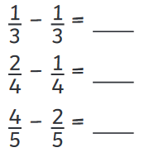
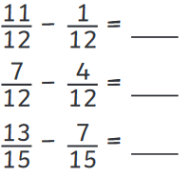
Your turn:
Look carefully at these ones:

Slide 12
Extra challenge for those wanting more.

