Slide 1
Class 4 Maths
Week 7 – Session 2
This week, we will be adding fractions above the whole.
There are a range of visuals to support you with this.

Slide 2
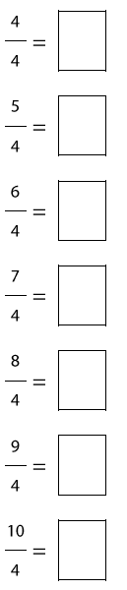
Patterns and Connections
Convert these improper fractions into mixed numbers.

Slide 3







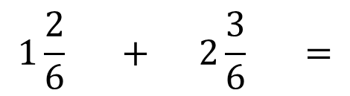
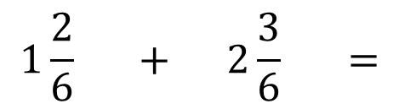
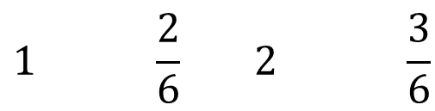
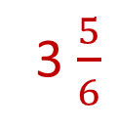


Adding mixed numbers
$$1\frac{2}{6} + 2\frac{3}{6} =$$
The easiest way to add two mixed numbers, is to add the whole numbers first and then the fraction.
$$1\frac{2}{6} + 2\frac{3}{6} =$$
3 $\frac{5}{6}$
$$1\frac{2}{6}$$
$$1 \frac{2}{6} 2 \frac{3}{6}$$
$$2\frac{3}{6}$$
$$1+2$$
$\frac{2}{6}$ + $\frac{3}{6}$
3
$$\frac{5}{6}$$

Slide 4







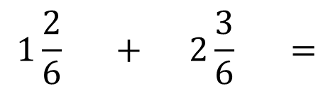

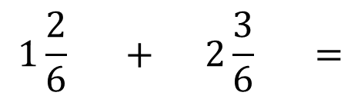


Adding mixed numbers
The easiest way to add two mixed numbers, is to add the whole numbers first and then the fraction.
$$1\frac{2}{6} + 2\frac{3}{6} =$$
$$1\frac{2}{6} + 2\frac{3}{6} =$$
3 $\frac{5}{6}$
$$1\frac{2}{6}$$
$$+\frac{3}{6}$$
$$3\frac{2}{6}$$
$$3\frac{5}{6}$$
$$2\frac{3}{6}$$

Slide 5

Your turn...
Use whichever visual best supports you to solve these:
$2\frac{2}{5} + 2\frac{2}{5}$ =
$5\frac{7}{9} + 3\frac{1}{9}$ =
$4\frac{1}{3} + 1\frac{1}{3}$ =

Slide 6




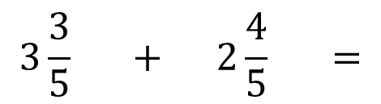



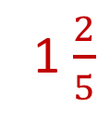
Now, we will look at adding mixed numbers where the fraction adds to more than the whole.
$$3\frac{3}{5} + 2\frac{4}{5} =$$
$$3\frac{3}{5}$$
$$\frac{7}{5}$$
1 $\frac{2}{5}$
=
$$2\frac{4}{5}$$

Slide 7



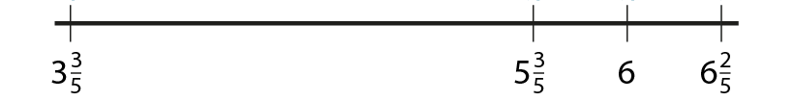






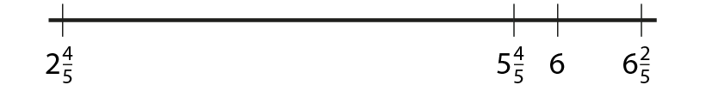
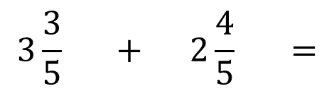


Now, we will look at adding mixed numbers where the fraction adds to more than the whole.
$$3\frac{3}{5} + 2\frac{4}{5} =$$
$$3\frac{3}{5}$$
$$2\frac{4}{5}$$

Slide 8

Your turn...
Use whichever visual best supports you to solve these:
$\frac{4}{5} + \frac{4}{5}$ =
$1\frac{4}{5} + 2\frac{2}{5}$ =
$3\frac{5}{8} + 3\frac{4}{8}$ =
$4\frac{1}{4} + 2\frac{2}{4}$ =

Slide 9
End of session 2
Well done everyone! I am sure you have worked hard at adding mixed numbers.
Optional: I have included a ‘4 in a row’ game for you that you could play with a family member. I have also included an independent worksheet that you may or may not want to complete.
Next week, we will work on subtracting mixed numbers.

