Slide 1
Maths Year 4
Multiplying fractions
Session 2
We will be multiplying unit and non-unit fractions against whole numbers.
For some of the answers, you will have to convert into mixed numbers.

Slide 2
Patterns and Connections
3 x 3 = 7 x 7 =
6 x 6 = 5 x 5 =
4 x 4 = 9 x 9 =
2 x 2 = 12 x 12 =

Slide 3
Remember: Multiplying fractions against a whole number is the same as repeated addition. When multiplying a fraction against a whole number, the denominator doesn’t change – only the numerator.

Slide 4
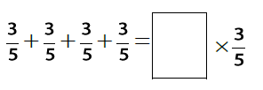
Complete:

Slide 5
Word problems
James is having a pizza party.
Each person at the party eats $\frac{3}{5}$ of a pizza.
There are 6 people at the party.
How many slices of pizza did they all eat?
Convert the answer into a mixed number to show how many whole pizzas were eaten.
$\frac{3}{5}$ + $\frac{3}{5}$ + $\frac{3}{5}$ + $\frac{3}{5}$ + $\frac{3}{5}$ + $\frac{3}{5}$ =
$\frac{3}{5}$ x 6 =
6 x $\frac{3}{5}$ =
How many slices of pizza did they all eat?
$\frac{18}{5}$
Convert the answer into a mixed number to show how many whole pizzas.
= 3 $\frac{3}{5}$

Slide 6
Your turn – remember to convert into mixed numbers.
Lucas walked $\frac{2}{6}$ of a kilometre each day for 8 days.
How many kilometres did she walk in total?
Thomas baked cheesecakes for a party. Each of his 8 guests ate $\frac{1}{5}$ of a cheesecakes.
How much cheesecake was eaten?
Daisy attended a 4-day Spanish course which lasted $\frac{3}{4}$ of an hour each day.
How many hours was the Spanish course in total?

Slide 7
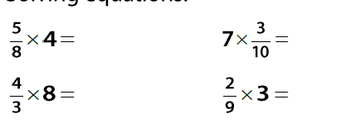
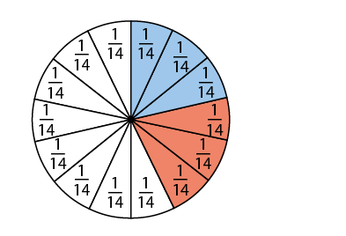
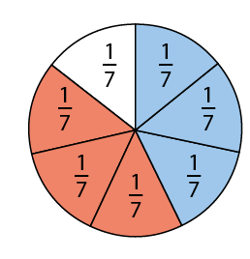
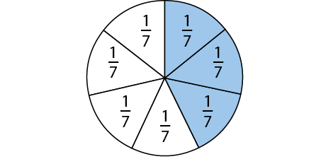
Which is true and which is false? Explain.
Convert the answers to mixed numbers
$$\frac{3}{7} x 2=$$
Optional challenge:

