Slide 1
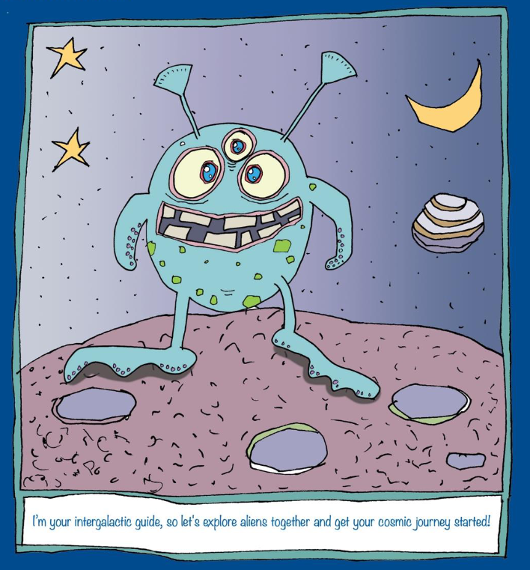
Literacy
This week, we are going to write a persuasive advert for an alien theme park/holiday camp.

Slide 2
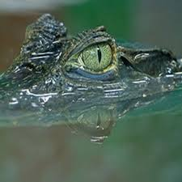
Zargon 10
Fabulous fun for all the family at Alien Park
Are you ever bored at the weekend? Do you long for something exciting to do? Why not zoom to Alien Park and enter an amazing world?
Crocodile World
Marvel at flying vampires. Wonder at the Dragons’ Cave. Be amazed by Crocodile World. There is also ample parking, a cool café and a stunning shop. Only 5 minutes from airstrip 21!
Join the Alien A-team!
The Dragons’ Cave

Slide 3
Creative design
Design your own alien theme park or holiday destination.
Think about what will make your theme park or holiday destination fun. How will you appeal to the whole family? What can you offer, that no other theme park or holiday destination can?
Will it have rollercoasters? Arcades? Gift shops? Café/restaurants? A playground? A castle/cave? Etc…

Slide 4
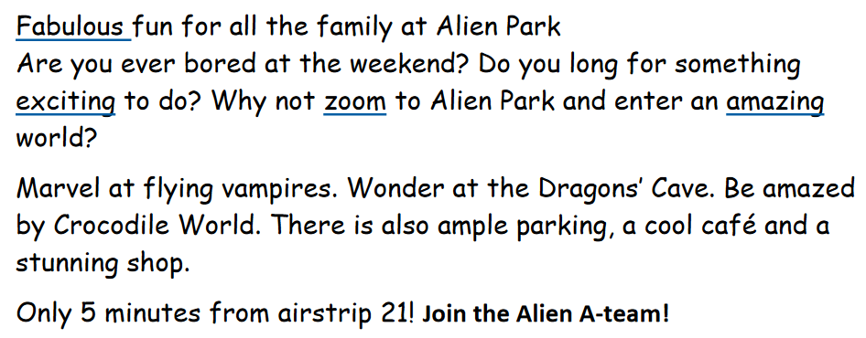
Unpicking the text

Slide 5
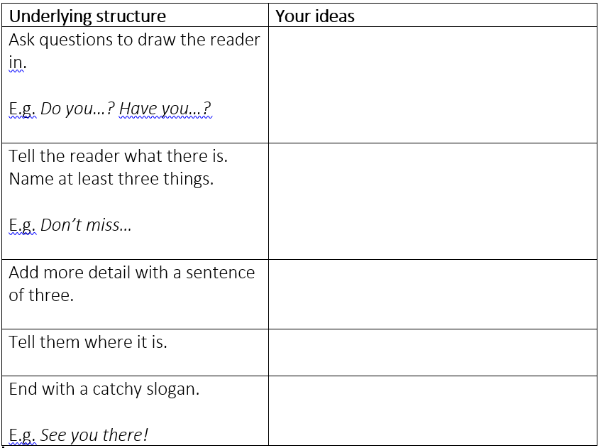
Let’s innovate…
What do you want to say about your alien theme park/ holiday destination?
Use the planner to plan your ideas.

Slide 6
Writing your persuasive advert
Now that you have designed your theme park / holiday destination and planned a persuasive advert to get people to go, you need to write it!
Look back at the model text for support if needed.

Slide 7
End of session 1
Great work everyone! I hope you enjoyed designing your own alien theme park / holiday destination and writing a persuasive advert for it.
If you would like to, send me your draft and I’ll return it with feedback for you to edit and write up.
You could include different fonts and pictures.

