Slide 1
Quadrilaterals and right angles

Slide 2
What is the same about these two shapes? What is different?
Think about:
How many sides they have
How many vertices they have

Slide 3
They both have 4 sides so they are both quadrilaterals. A square is a kind of quadrilateral.

Slide 4
How many of these shapes are quadrilaterals?

Slide 5
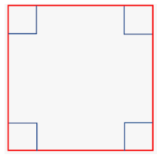
Squares and rectangles are quadrilaterals which have right angles at the vertices.

Slide 6
Make a right angle finder using the corner of a piece of paper. Use it to find some things in your house which have at least one right angle.
Right angle

