Slide 1
3
7
POWERPOINT 2
Maths- Summer 1 Week 2

Slide 2
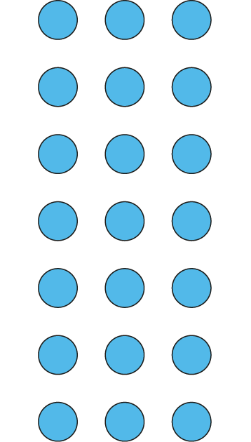
Circle the groups of 3.
Circle the 3 equal groups.
7
7
There are groups of 3.
There are 3 groups of .
3 ×
7
=
21
7
× 3 =
21

Slide 3
Cartons of juice come in packs of 3. How many juice cartons are there in 4 packs?
Click on this link to watch the video
https://youtu.be/C-fq54o3TjY

Slide 4
Have a go at this question now. Draw it out the way that I did. Show the calculation both ways and what we would do to add in one more group.
Activity 1 – Have a go and then the next slide will show you how I have done it.
James buys 5 packs of 3 pencils. How many pencils does he have altogether? Show both multiplications for this.
James then buys one more packet. Show how this can be done with an addition and what the multiplication will be.

Slide 5
This is what I did for the pencil problem
Click on the link for a video
https://youtu.be/LS8r8CWXh8M

Slide 6
Stop the PowerPoint here as the next session will look at using your multiplication knowledge to solve division.
☺

Slide 7
Session 2 – Now use the second part of the PowerPoint to help you solve the next questions. Using multiplication facts to solve division
Mrs Warrington has a piece of ribbon.
The ribbon is 36 centimeters long.
If she splits the ribbon into three equal pieces how long will each piece be?
Have a go at this practically. Draw 36 dots on a piece of paper, use buttons or peas, anything that you have got to hand.

Slide 8
Click on the link for a video
https://youtu.be/JwRf77508CE

Slide 9
To show the calculations for the ribbon problem, we can write a division or a multiplication.
36 ➗ 3 = 12
3 X 12= 36
We can use our multiplication facts to help us.

Slide 10
If a tricycle factory has 33 wheels. How many tricycles can they make?
Have a go. Draw it out like we did for the ribbon problem.
Write the division and multiplication to show your answer.

Slide 11
Click on the link for a video
https://youtu.be/19y7ALzs39w

Slide 12
Now can you have a go at creating your own problems with practical objects in groups of 3? Carry on drawing your representations the way we have done together on these slides.
Make sure the number you start with is in the 3 times table. Tweet me any of yours that you would like me to solve. Just don’t make them too hard for me!
☺

